Slide 1

Drone delivery system unit
Day 2
Standards:
8.PS2.3
8PS2.4
8.PS2.5

Slide 2
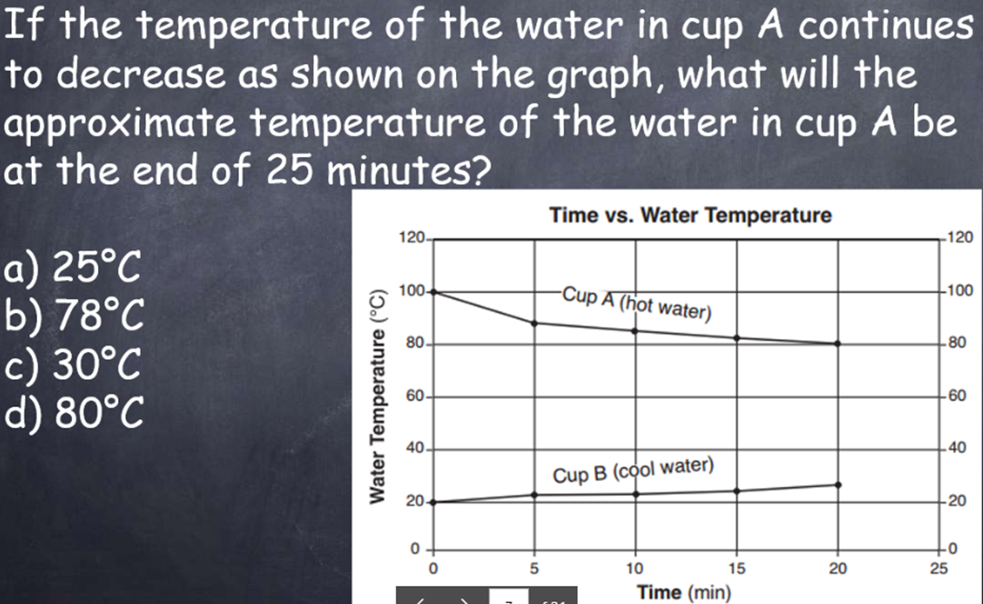


Slide 3
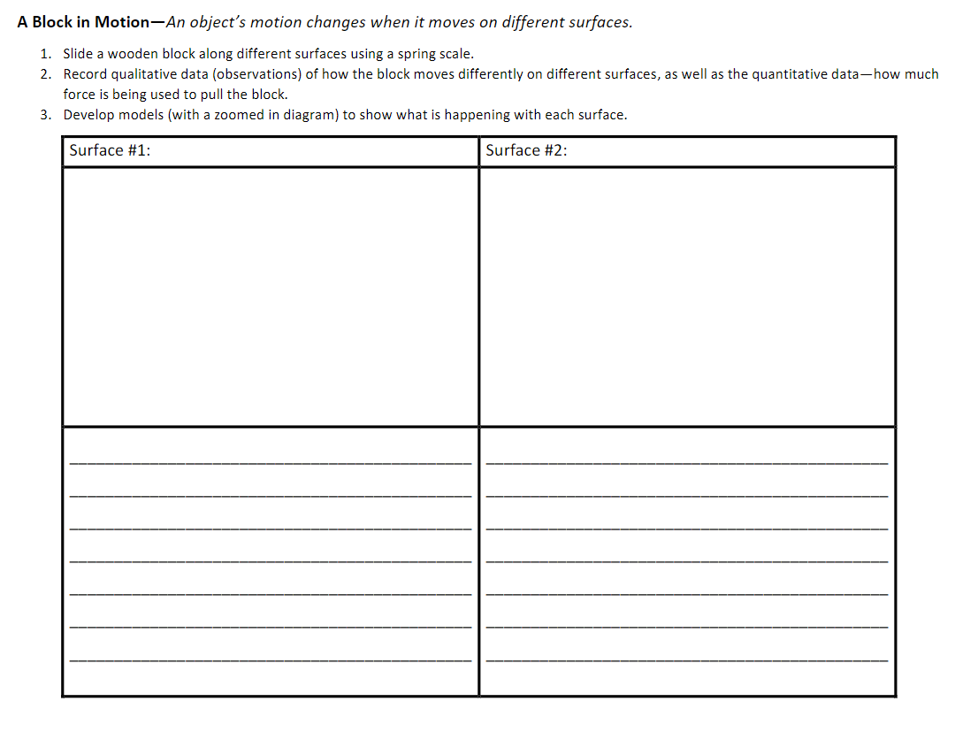
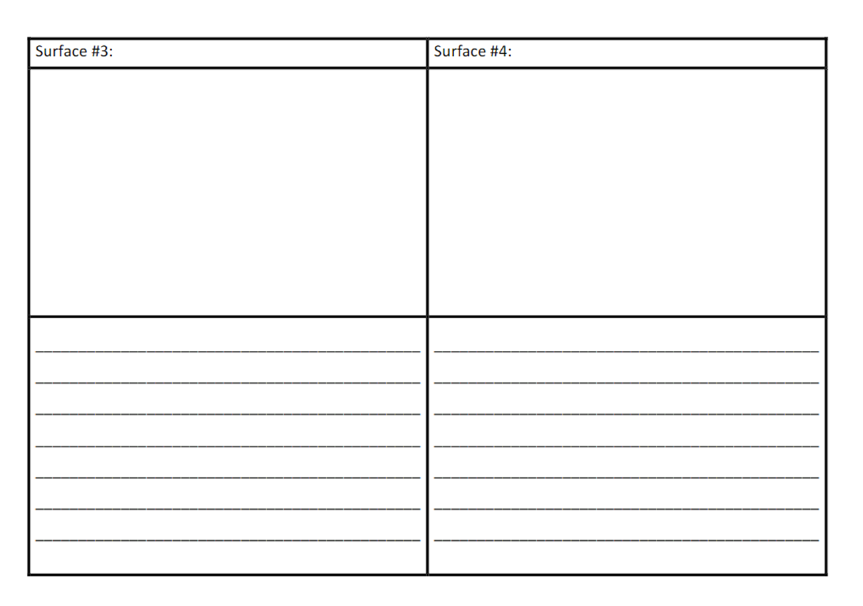
Finish your investigation of the block in motion.
Standards: 8.PS2.3, 8PS2.4, 8.PS2.5

Slide 4
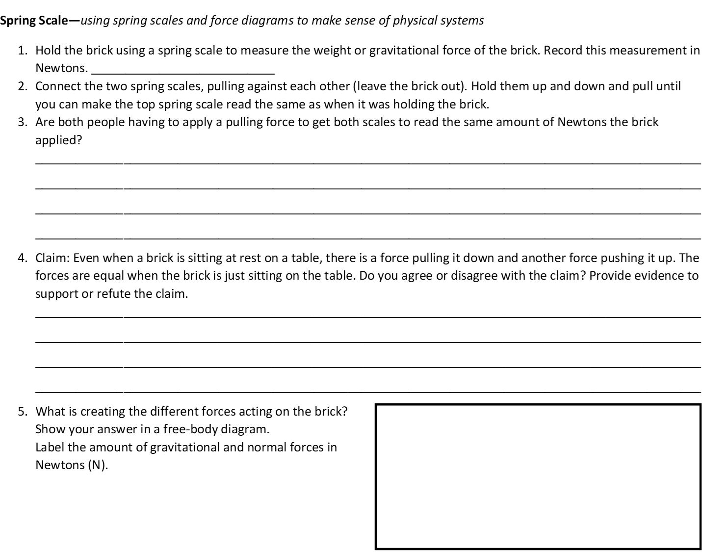
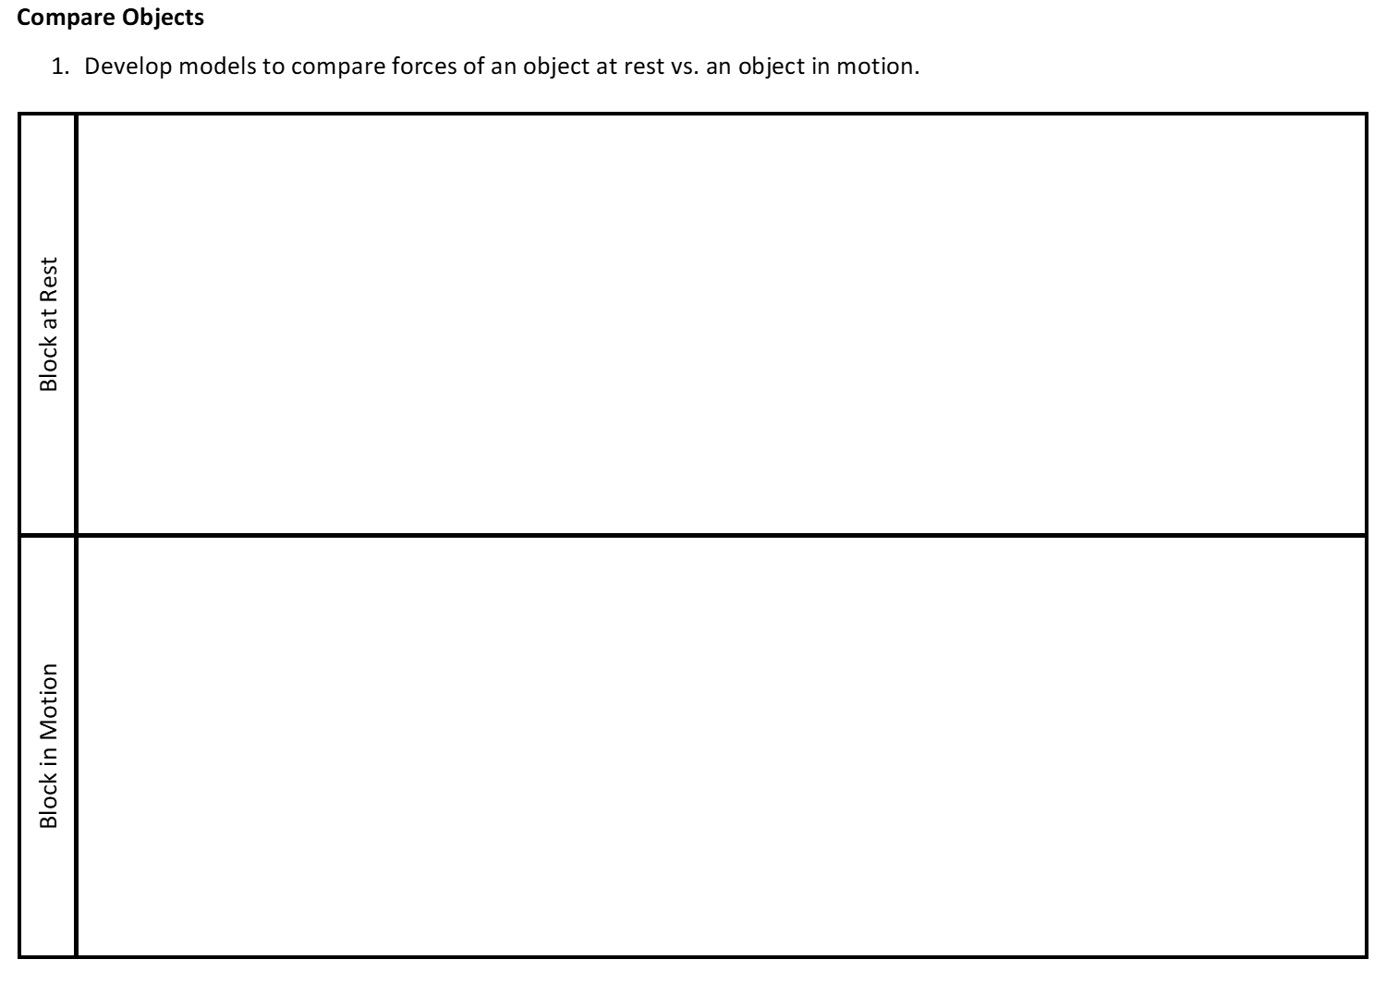
Free body diagrams link
2. Construct an explanation describing the forces acting on the block at rest and the block in motion, including the motion of the object on each surface.
Standards: 8.PS2.3, 8PS2.4, 8.PS2.5

Slide 5
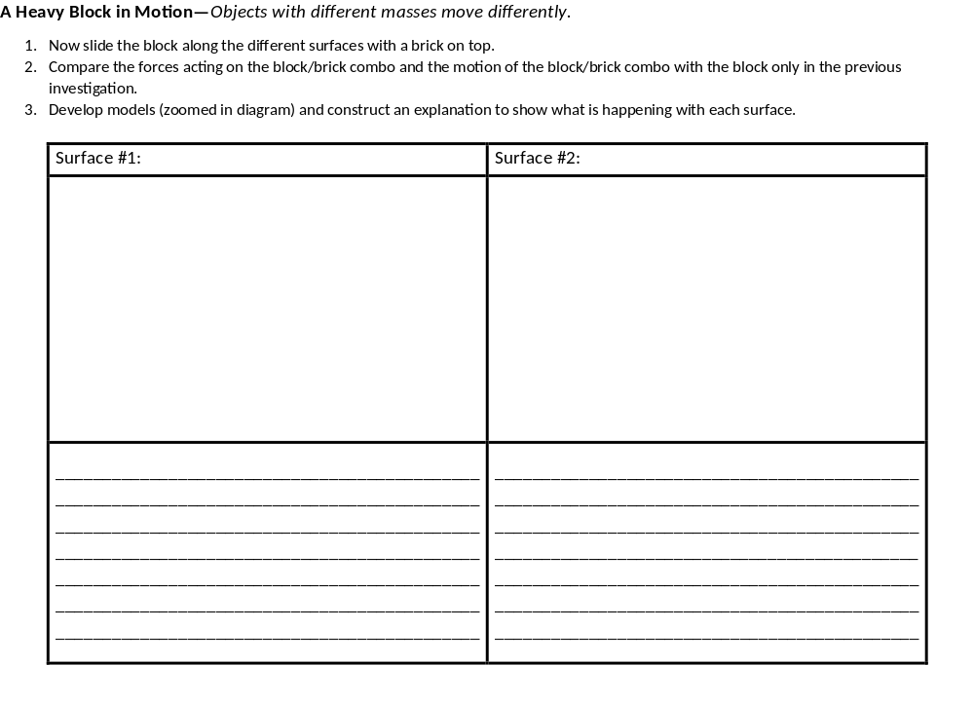
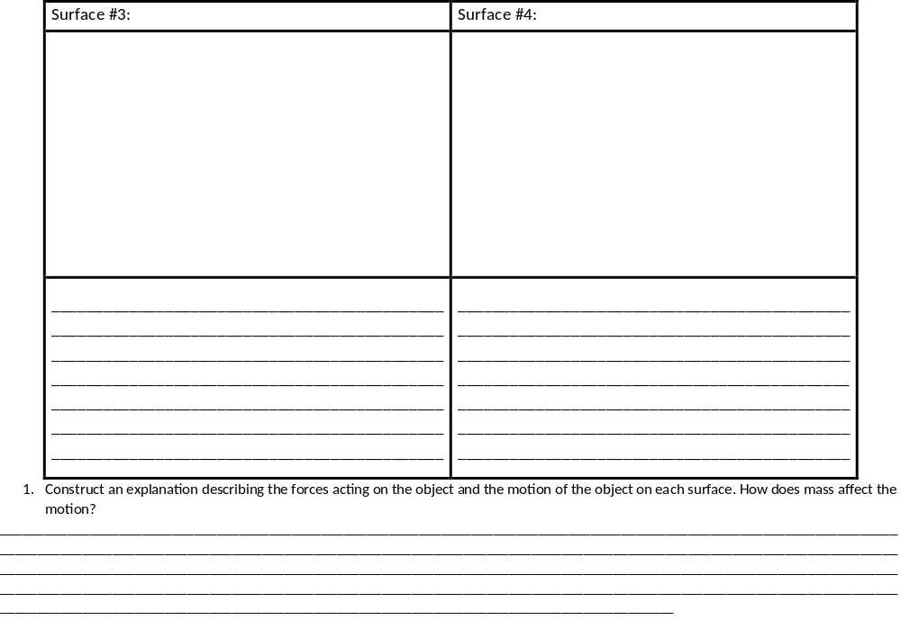
Standards: 8.PS2.3, 8PS2.4, 8.PS2.5

Slide 6
Go back to your initial model and claim of what is causing the supplies to be damaged and use newly learned information to revise your model and explanation of the anchoring phenomenon. Focus on the different forces that affect the supplies when dropped and add a free body diagram to represent the forces on the supplies.

Slide 7
Exit Ticket:
What forces are acting on the block?

